Slide 1



RSG – Turkey 2021 Student Symposium Command Line Basics
Eda Şamiloğlu

Slide 2
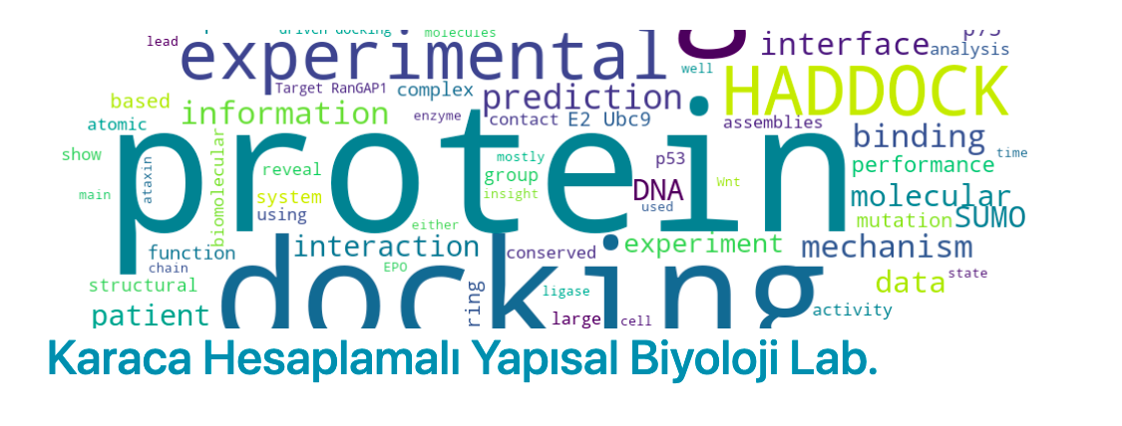
B.Sc
Molecular Biology and Genetics
2014-2019
M.Sc Student
Karaca Lab

Slide 3
Command Line Basics
Command is a specific input type; “Show me all my files!”
Command line is the current line within the terminal which can be used to input text commands.
The command line allows users to run a vast range of commands.
It is also the starting point for running most bioinformatics software.

Slide 4
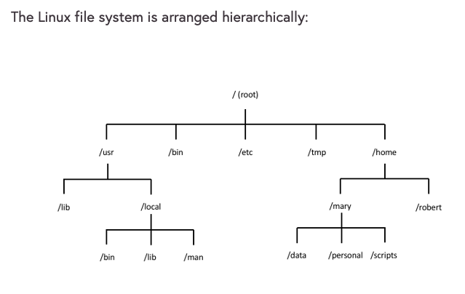


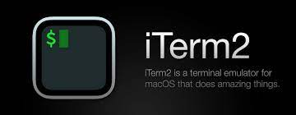
Directories and Files
In the operating systems, information is stored in files.
Open your terminal or an online cloud shell!
Your file organization
might be different

Slide 5
Directories and Files
In Linux, as with other operating systems, information is stored in files.
pwd:
The pwd command displays (“prints” to the screen) the current working directory.
whoami:
Displays your logged in user id.

Slide 6
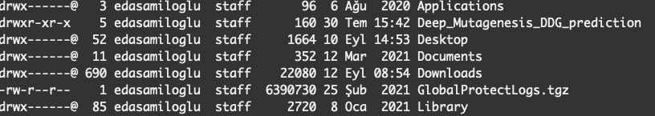
Listing directories and files
ls: Directory listing.
ls –l: long version

Slide 7
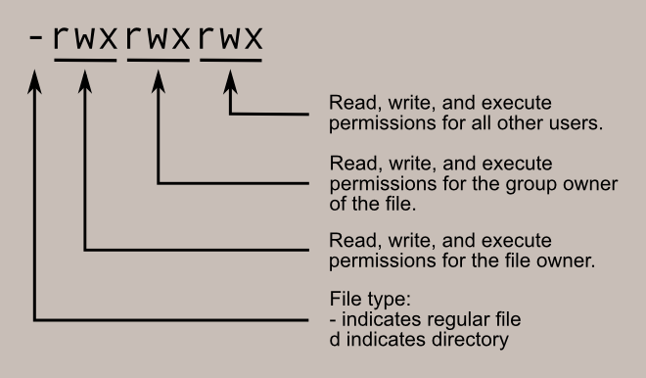
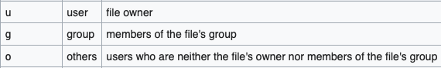
Changing the current directory
ls –l: long version
chmod: used to change the access permissions of files and directories, known as modes.
chmod o+w GlobalProtectLogs.tgz

Slide 8
Changing the current directory
cd: Change current working directory.
cd Desktop/
pwd
cd ..
Then
List existing file and directories, ls
cd : Back to home directory.
pwd

Slide 9
Clear the terminal screen and explore man
clear: Clear the terminal screen.
man: Man pages, the user manual.
man clear

Slide 10
Create a directory and using text editor nano
mkdir: The mkdir command creates a directory.
mkdir Command_Line_Basics
cd Command_Line_Basics
mkdir example
cd example
ls
touch file
open file
nano file
name: Eda
surname: Şamiloğlu
workshop: RSG-Turkey Command Line Tools
session name: Command Line Basics

Slide 11
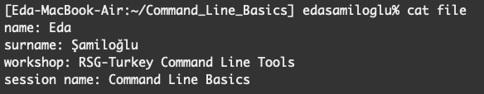
Display file content
cat : The cat utility reads files sequentially, writing them to the standard output.
cat file

Slide 12
Copy and Move files
cp: Copies the contents of the source-file to the target-file.
mv: move files and directories from one directory to another or to rename a file or directory.

Slide 13
Combining command lines
cp file first_nano_experience
mv first_nano_experience ..
rm file
ls
cd ..
rmdir example (rm –r)

Slide 14
Working with FASTA file - sequence.fasta
wget https://raw.githubusercontent.com/rsgturkey/Workshop2021/main/Command_Line_Basics/sequence.fasta .

Slide 15
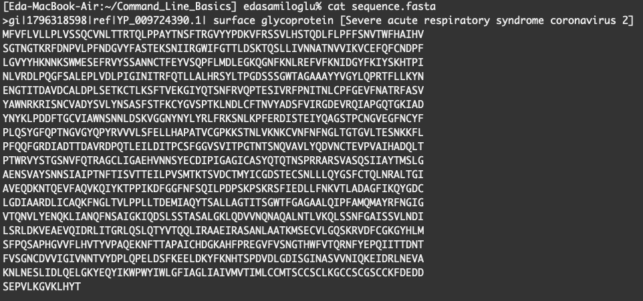
Working with FASTA file - sequence.fasta
cat sequence.fasta
nano sequence.fasta

Slide 16
Working with FASTA file - sequence.fasta
mv sequence.fasta surface_glycoprotein
head surface_glycoprotein
head -1 surface_glycoprotein
tail surface_glycoprotein

Slide 17
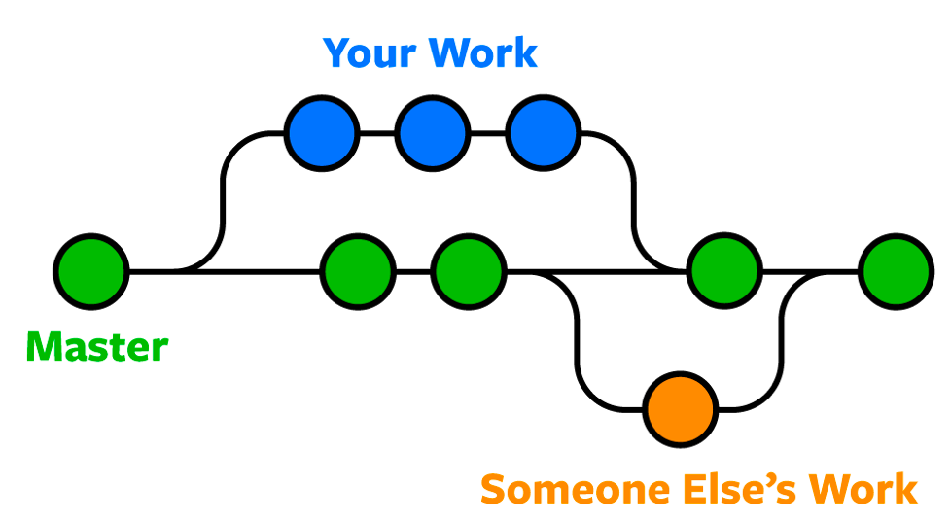
Bonus: git version control
Git is the most commonly used version control system.

Slide 18
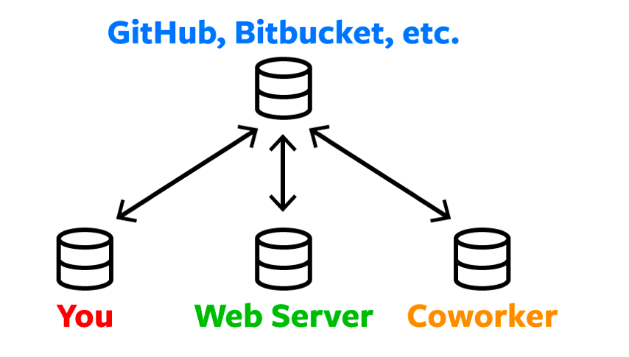
Bonus: git version control
Storing a copy of your Git repo with an online host (Github or Bitbucket)
There are a lot of different ways to use Git.
There are the original command-line tools, and there are many graphical user interfaces of varying capabilities.

Slide 19
Bonus: git version control via terminal
mkdir my_project
cd my_project/
cp ../surface_glycoprotein .
ls
git init:
ls -la
git add: The command used to add a file that is in the working directory to the staging area.
git add surface_glycoprotein

Slide 20
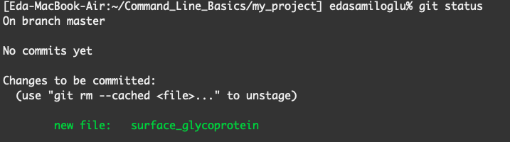
Bonus: git version control
git status: Lists all new or modified files to be committed
git commit -m "new file added"

Slide 21
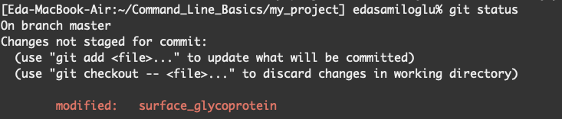
Bonus: git version control
nano surface_glycoprotein and remove first line
git diff
To save changes:

Slide 22
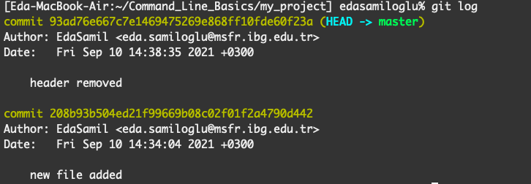
Bonus: git version control
git log: To see the history of commit you made to your files.

Slide 23

Bonus: git version control via GitHub
GitHub, is a provider of internet hosting for version control using Git.

Slide 24

Bonus: git version control via GitHub

Slide 25
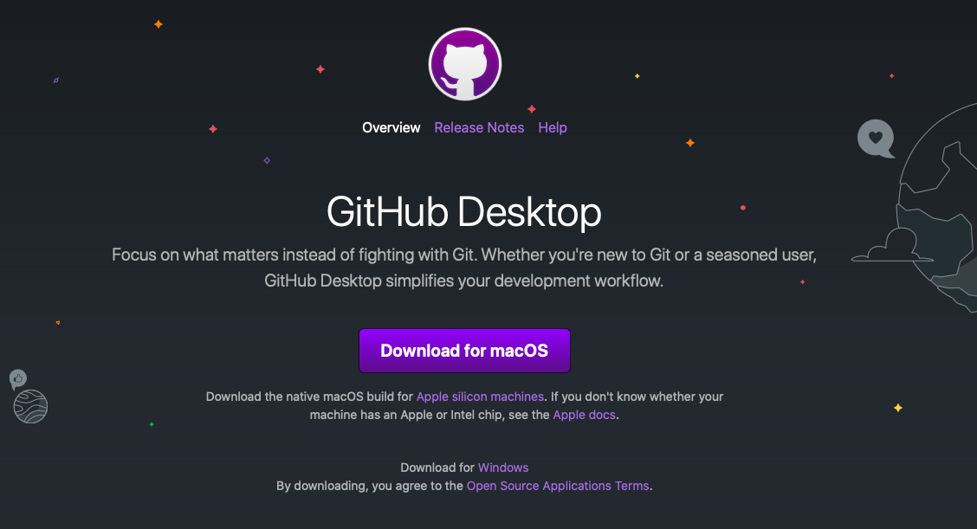
Bonus: git version control GitHub Desktop

Slide 26


Slide 27
